Slide 1
Gradient Descent
Notes:
Gradient Descent 梯度下降法
Stochastic 随机
Data normalization 数据归一化
Tuning your learning rates 调整学习率
Learning Rate 如果刚刚好，Learning Rate 顺着红色箭头走到最低点
Learning Rate 如果太小，步伐太小，如蓝色箭头所示，虽然也会走到最低点，但是速度会很慢
Learning Rate 如果太大，步伐太大，如绿色箭头所示，那么就走不到最低点，它永远在最低点两边震荡
Learning Rate 如果特别大，步伐特别大，如黄色箭头所示，那么参数就会越来越大，永远不能到达最低点
Adaptive Learning Rates 自适应学习率
Popular & Simple Idea: Reduce the learning rate by some factor every few epochs. 流行和简单的想法：每隔几个epoch就减少一些学习率。
At the beginning, we are far from the destination, so we use larger learning rate 一开始，我们离目的地很远，所以我们使用较大的学习率
After several epochs, we are close to the destination, so we reduce the learning rate 经过几个epoch之后，我们接近了目的地，所以我们降低了学习率
E.g. 1/t decay: 𝜂^𝑡=𝜂∕√(𝑡+1) 1/t衰变
Learning rate cannot be one-size-fits-all 学习率不可能是放之四海而皆准的
Giving different parameters different learning rates 给出不同的参数不同的学习率
Feature Scaling 特征缩放
Theory 理论

Slide 2


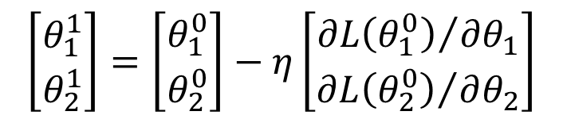
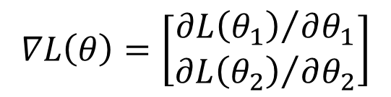
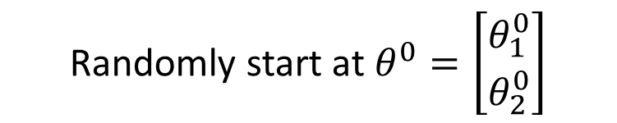

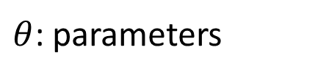
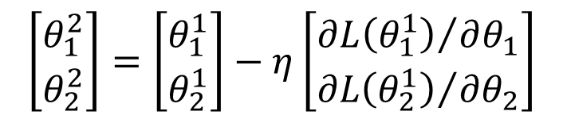
Review: Gradient Descent
In step 3, we have to solve the following optimization problem:
$$θ^{∗}=arg\min_{θ}{L\left(θ\right)}$$
L: loss function
$θ$: parameters
Suppose that θ has two variables {θ₁, θ₂}
Randomly start at $θ^{0}=\left[\begin{matrix}θ_{1}^{0} \\ θ_{2}^{0}\end{matrix}\right]$
$$∇L\left(θ\right)=\left[\begin{matrix}{∂L\left(θ_{1}\right)}/{∂θ_{1}} \\ {∂L\left(θ_{2}\right)}/{∂θ_{2}}\end{matrix}\right]$$
$$\left[\begin{matrix}θ_{1}^{1} \\ θ_{2}^{1}\end{matrix}\right]=\left[\begin{matrix}θ_{1}^{0} \\ θ_{2}^{0}\end{matrix}\right]−η\left[\begin{matrix}{∂L\left(θ_{1}^{0}\right)}/{∂θ_{1}} \\ {∂L\left(θ_{2}^{0}\right)}/{∂θ_{2}}\end{matrix}\right]$$
$$θ^{1}=θ^{0}−η∇L\left(θ^{0}\right)$$
$$\left[\begin{matrix}θ_{1}^{2} \\ θ_{2}^{2}\end{matrix}\right]=\left[\begin{matrix}θ_{1}^{1} \\ θ_{2}^{1}\end{matrix}\right]−η\left[\begin{matrix}{∂L\left(θ_{1}^{1}\right)}/{∂θ_{1}} \\ {∂L\left(θ_{2}^{1}\right)}/{∂θ_{2}}\end{matrix}\right]$$
$$θ^{2}=θ^{1}−η∇L\left(θ^{1}\right)$$
Notes:
Gradient Descent 梯度下降法
Stochastic 随机
Data normalization 数据归一化
Tuning your learning rates 调整学习率
Learning Rate 如果刚刚好，Learning Rate 顺着红色箭头走到最低点
Learning Rate 如果太小，步伐太小，如蓝色箭头所示，虽然也会走到最低点，但是速度会很慢
Learning Rate 如果太大，步伐太大，如绿色箭头所示，那么就走不到最低点，它永远在最低点两边震荡
Learning Rate 如果特别大，步伐特别大，如黄色箭头所示，那么参数就会越来越大，永远不能到达最低点
Adaptive Learning Rates 自适应学习率
Popular & Simple Idea: Reduce the learning rate by some factor every few epochs. 流行和简单的想法：每隔几个epoch就减少一些学习率。
At the beginning, we are far from the destination, so we use larger learning rate 一开始，我们离目的地很远，所以我们使用较大的学习率
After several epochs, we are close to the destination, so we reduce the learning rate 经过几个epoch之后，我们接近了目的地，所以我们降低了学习率
E.g. 1/t decay: 𝜂^𝑡=𝜂∕√(𝑡+1) 1/t衰变
Learning rate cannot be one-size-fits-all 学习率不可能是放之四海而皆准的
Giving different parameters different learning rates 给出不同的参数不同的学习率
Feature Scaling 特征缩放
Theory 理论

Slide 3

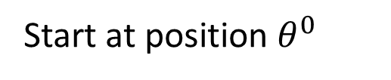
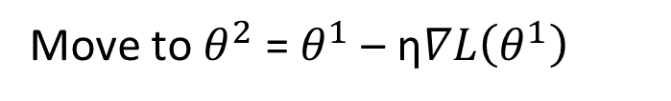


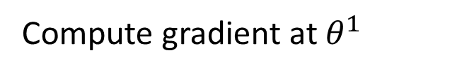
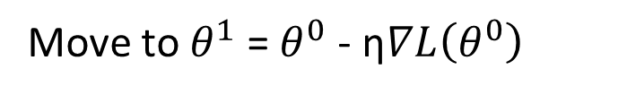

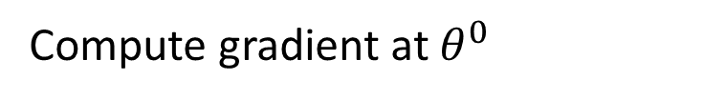

Review: Gradient Descent
$$θ_{2}$$
Gradient: Loss 的等高線的法線方向
$$∇L\left(θ^{0}\right)$$
Start at position $θ^{0}$
$$θ^{0}$$
$$∇L\left(θ^{1}\right)$$
Compute gradient at $θ^{0}$
$$θ^{1}$$
$$∇L\left(θ^{2}\right)$$
Move to $θ^{1}$ = $θ^{0}$ - η$∇L\left(θ^{0}\right)$
$$θ^{2}$$
Gradient
Compute gradient at $θ^{1}$
Movement
$$∇L\left(θ^{3}\right)$$
$$θ^{3}$$
Move to $θ^{2}$ = $θ^{1}$ – η$∇L\left(θ^{1}\right)$
……
$$θ_{1}$$
Notes:
Gradient Descent 梯度下降法
Stochastic 随机
Data normalization 数据归一化
Tuning your learning rates 调整学习率
Learning Rate 如果刚刚好，Learning Rate 顺着红色箭头走到最低点
Learning Rate 如果太小，步伐太小，如蓝色箭头所示，虽然也会走到最低点，但是速度会很慢
Learning Rate 如果太大，步伐太大，如绿色箭头所示，那么就走不到最低点，它永远在最低点两边震荡
Learning Rate 如果特别大，步伐特别大，如黄色箭头所示，那么参数就会越来越大，永远不能到达最低点
Adaptive Learning Rates 自适应学习率
Popular & Simple Idea: Reduce the learning rate by some factor every few epochs. 流行和简单的想法：每隔几个epoch就减少一些学习率。
At the beginning, we are far from the destination, so we use larger learning rate 一开始，我们离目的地很远，所以我们使用较大的学习率
After several epochs, we are close to the destination, so we reduce the learning rate 经过几个epoch之后，我们接近了目的地，所以我们降低了学习率
E.g. 1/t decay: 𝜂^𝑡=𝜂∕√(𝑡+1) 1/t衰变
Learning rate cannot be one-size-fits-all 学习率不可能是放之四海而皆准的
Giving different parameters different learning rates 给出不同的参数不同的学习率
Feature Scaling 特征缩放
Theory 理论

Slide 4
Gradient Descent
Tip 1: Tuning your
learning rates
Notes:
Gradient Descent 梯度下降法
Stochastic 随机
Data normalization 数据归一化
Tuning your learning rates 调整学习率
Learning Rate 如果刚刚好，Learning Rate 顺着红色箭头走到最低点
Learning Rate 如果太小，步伐太小，如蓝色箭头所示，虽然也会走到最低点，但是速度会很慢
Learning Rate 如果太大，步伐太大，如绿色箭头所示，那么就走不到最低点，它永远在最低点两边震荡
Learning Rate 如果特别大，步伐特别大，如黄色箭头所示，那么参数就会越来越大，永远不能到达最低点
Adaptive Learning Rates 自适应学习率
Popular & Simple Idea: Reduce the learning rate by some factor every few epochs. 流行和简单的想法：每隔几个epoch就减少一些学习率。
At the beginning, we are far from the destination, so we use larger learning rate 一开始，我们离目的地很远，所以我们使用较大的学习率
After several epochs, we are close to the destination, so we reduce the learning rate 经过几个epoch之后，我们接近了目的地，所以我们降低了学习率
E.g. 1/t decay: 𝜂^𝑡=𝜂∕√(𝑡+1) 1/t衰变
Learning rate cannot be one-size-fits-all 学习率不可能是放之四海而皆准的
Giving different parameters different learning rates 给出不同的参数不同的学习率
Feature Scaling 特征缩放
Theory 理论

Slide 5
Learning Rate
Set the learning rate η carefully
If there are more than three parameters, you cannot visualize this.
Loss
Very Large
small
Large
Loss
Just make
No. of parameters updates
But you can always visualize this.
Notes:
Gradient Descent 梯度下降法
Stochastic 随机
Data normalization 数据归一化
Tuning your learning rates 调整学习率
Learning Rate 如果刚刚好，Learning Rate 顺着红色箭头走到最低点
Learning Rate 如果太小，步伐太小，如蓝色箭头所示，虽然也会走到最低点，但是速度会很慢
Learning Rate 如果太大，步伐太大，如绿色箭头所示，那么就走不到最低点，它永远在最低点两边震荡
Learning Rate 如果特别大，步伐特别大，如黄色箭头所示，那么参数就会越来越大，永远不能到达最低点
Adaptive Learning Rates 自适应学习率
Popular & Simple Idea: Reduce the learning rate by some factor every few epochs. 流行和简单的想法：每隔几个epoch就减少一些学习率。
At the beginning, we are far from the destination, so we use larger learning rate 一开始，我们离目的地很远，所以我们使用较大的学习率
After several epochs, we are close to the destination, so we reduce the learning rate 经过几个epoch之后，我们接近了目的地，所以我们降低了学习率
E.g. 1/t decay: 𝜂^𝑡=𝜂∕√(𝑡+1) 1/t衰变
Learning rate cannot be one-size-fits-all 学习率不可能是放之四海而皆准的
Giving different parameters different learning rates 给出不同的参数不同的学习率
Feature Scaling 特征缩放
Theory 理论

Slide 6
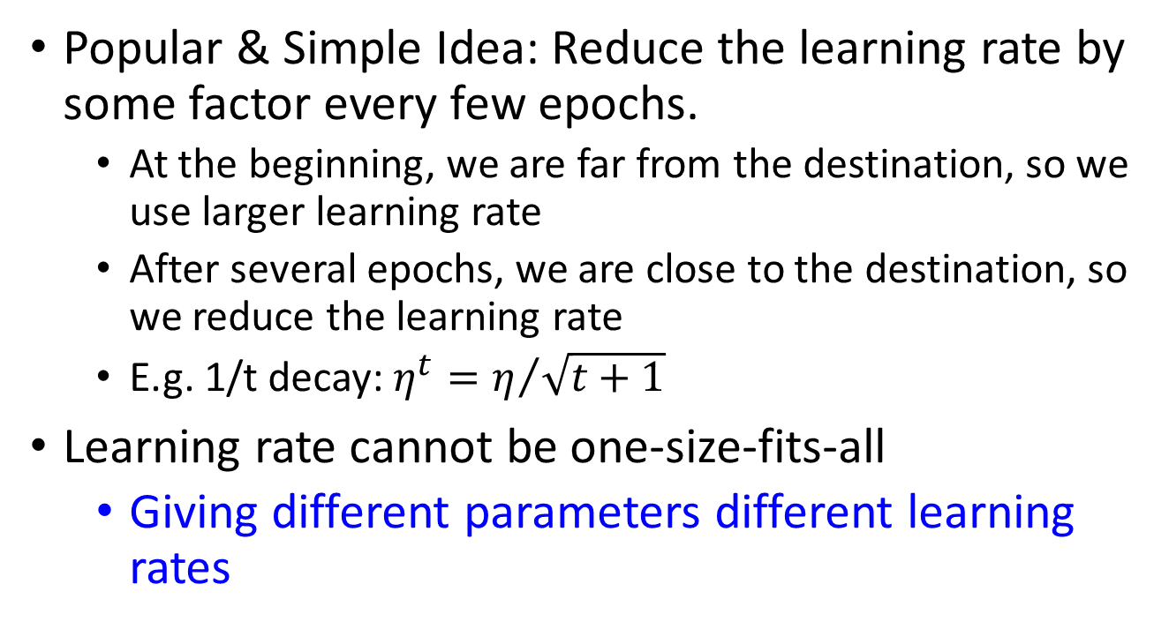
Adaptive Learning Rates
  Popular & Simple Idea: Reduce the learning rate by some factor every few epochs.
  At the beginning, we are far from the destination, so we use larger learning rate
  After several epochs, we are close to the destination, so we reduce the learning rate
  E.g. 1/t decay: $η^{t}=η/{\sqrt{t+1}}$
Learning rate cannot be one-size-fits-all
  Giving different parameters different learning rates
Notes:
Gradient Descent 梯度下降法
Stochastic 随机
Data normalization 数据归一化
Tuning your learning rates 调整学习率
Learning Rate 如果刚刚好，Learning Rate 顺着红色箭头走到最低点
Learning Rate 如果太小，步伐太小，如蓝色箭头所示，虽然也会走到最低点，但是速度会很慢
Learning Rate 如果太大，步伐太大，如绿色箭头所示，那么就走不到最低点，它永远在最低点两边震荡
Learning Rate 如果特别大，步伐特别大，如黄色箭头所示，那么参数就会越来越大，永远不能到达最低点
Adaptive Learning Rates 自适应学习率
Popular & Simple Idea: Reduce the learning rate by some factor every few epochs. 流行和简单的想法：每隔几个epoch就减少一些学习率。
At the beginning, we are far from the destination, so we use larger learning rate 一开始，我们离目的地很远，所以我们使用较大的学习率
After several epochs, we are close to the destination, so we reduce the learning rate 经过几个epoch之后，我们接近了目的地，所以我们降低了学习率
E.g. 1/t decay: 𝜂^𝑡=𝜂∕√(𝑡+1) 1/t衰变
Learning rate cannot be one-size-fits-all 学习率不可能是放之四海而皆准的
Giving different parameters different learning rates 给出不同的参数不同的学习率
Feature Scaling 特征缩放
Theory 理论

Slide 7
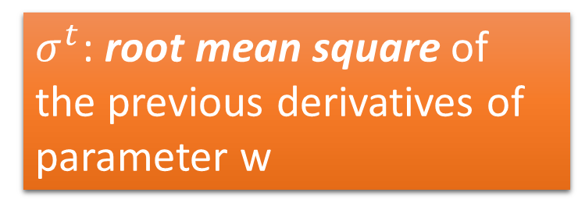
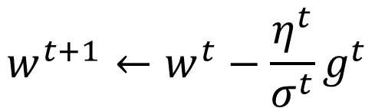



Adagrad
$$η^{t}=\frac{η}{\sqrt{t+1}}$$
$$g^{t}=\frac{∂L\left(θ^{t}\right)}{∂w}$$
Divide the learning rate of each parameter by the root mean square of its previous derivatives
Vanilla Gradient descent
$$w^{t+1}←w^{t}−{\text{η}}^{t}g^{t}$$
w is one parameters
Adagrad
$σ^{t}$: root mean square of the previous derivatives of parameter w
$$w^{t+1}←w^{t}−\frac{{\text{η}}^{t}}{σ^{t}}g^{t}$$
Parameter dependent
Notes:
Gradient Descent 梯度下降法
Stochastic 随机
Data normalization 数据归一化
Tuning your learning rates 调整学习率
Learning Rate 如果刚刚好，Learning Rate 顺着红色箭头走到最低点
Learning Rate 如果太小，步伐太小，如蓝色箭头所示，虽然也会走到最低点，但是速度会很慢
Learning Rate 如果太大，步伐太大，如绿色箭头所示，那么就走不到最低点，它永远在最低点两边震荡
Learning Rate 如果特别大，步伐特别大，如黄色箭头所示，那么参数就会越来越大，永远不能到达最低点
Adaptive Learning Rates 自适应学习率
Popular & Simple Idea: Reduce the learning rate by some factor every few epochs. 流行和简单的想法：每隔几个epoch就减少一些学习率。
At the beginning, we are far from the destination, so we use larger learning rate 一开始，我们离目的地很远，所以我们使用较大的学习率
After several epochs, we are close to the destination, so we reduce the learning rate 经过几个epoch之后，我们接近了目的地，所以我们降低了学习率
E.g. 1/t decay: 𝜂^𝑡=𝜂∕√(𝑡+1) 1/t衰变
Learning rate cannot be one-size-fits-all 学习率不可能是放之四海而皆准的
Giving different parameters different learning rates 给出不同的参数不同的学习率
Adagrad
Stochastic Gradient descent 随机
Vanilla Gradient descent
Feature Scaling 特征缩放
Theory 理论

Slide 8
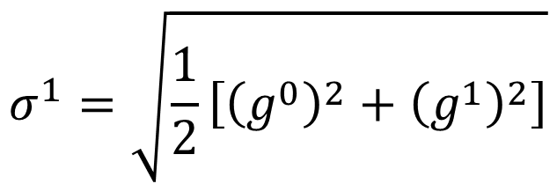
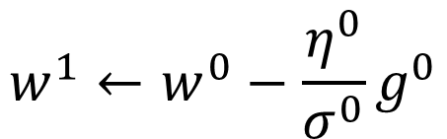


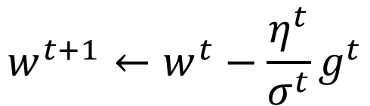
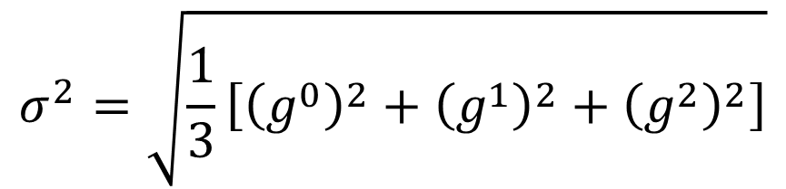
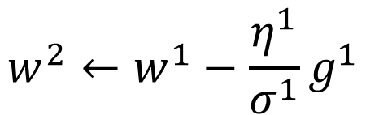
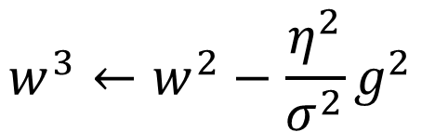

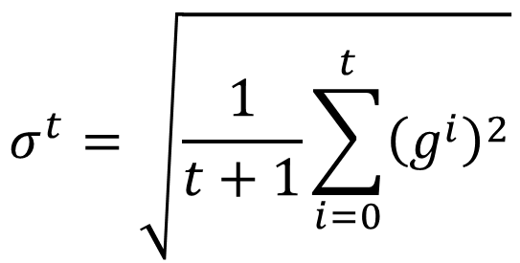
Adagrad
$σ^{t}$: root mean square of the previous derivatives of parameter w
$$w^{1}←w^{0}−\frac{{\text{η}}^{0}}{σ^{0}}g^{0}$$
$$σ^{0}=\sqrt{{\left(g^{0}\right)}^{2}}$$
$$σ^{1}=\sqrt{\frac{1}{2}\left[{\left(g^{0}\right)}^{2}+{\left(g^{1}\right)}^{2}\right]}$$
$$w^{2}←w^{1}−\frac{{\text{η}}^{1}}{σ^{1}}g^{1}$$
$$σ^{2}=\sqrt{\frac{1}{3}\left[{\left(g^{0}\right)}^{2}+{\left(g^{1}\right)}^{2}+{\left(g^{2}\right)}^{2}\right]}$$
$$w^{3}←w^{2}−\frac{{\text{η}}^{2}}{σ^{2}}g^{2}$$
$$……$$
$$σ^{t}=\sqrt{\frac{1}{t+1}\sum_{i=0}^{t}{{\left(g^{i}\right)}^{2}}}$$
$$w^{t+1}←w^{t}−\frac{{\text{η}}^{t}}{σ^{t}}g^{t}$$
Notes:
Gradient Descent 梯度下降法
Stochastic 随机
Data normalization 数据归一化
Tuning your learning rates 调整学习率
Learning Rate 如果刚刚好，Learning Rate 顺着红色箭头走到最低点
Learning Rate 如果太小，步伐太小，如蓝色箭头所示，虽然也会走到最低点，但是速度会很慢
Learning Rate 如果太大，步伐太大，如绿色箭头所示，那么就走不到最低点，它永远在最低点两边震荡
Learning Rate 如果特别大，步伐特别大，如黄色箭头所示，那么参数就会越来越大，永远不能到达最低点
Adaptive Learning Rates 自适应学习率
Popular & Simple Idea: Reduce the learning rate by some factor every few epochs. 流行和简单的想法：每隔几个epoch就减少一些学习率。
At the beginning, we are far from the destination, so we use larger learning rate 一开始，我们离目的地很远，所以我们使用较大的学习率
After several epochs, we are close to the destination, so we reduce the learning rate 经过几个epoch之后，我们接近了目的地，所以我们降低了学习率
E.g. 1/t decay: 𝜂^𝑡=𝜂∕√(𝑡+1) 1/t衰变
Learning rate cannot be one-size-fits-all 学习率不可能是放之四海而皆准的
Giving different parameters different learning rates 给出不同的参数不同的学习率
Adagrad
Stochastic Gradient descent 随机
Vanilla Gradient descent
Feature Scaling 特征缩放
Theory 理论

Slide 9




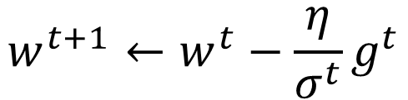
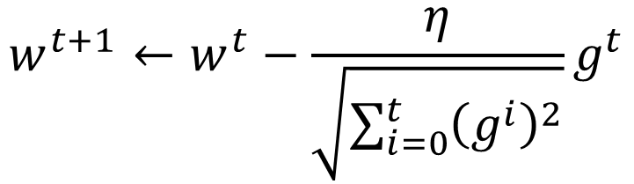
Adagrad
Divide the learning rate of each parameter by the root mean square of its previous derivatives
$$η^{t}=\frac{η}{\sqrt{t+1}}$$
1/t decay
$${\text{η}}^{t}$$
$$w^{t+1}←w^{t}−\frac{η}{σ^{t}}g^{t}$$
$$σ^{t}=\sqrt{\frac{1}{t+1}\sum_{i=0}^{t}{{\left(g^{i}\right)}^{2}}}$$
$$σ^{t}$$
$$w^{t+1}←w^{t}−\frac{η}{\sqrt{\sum_{i=0}^{t}{{\left(g^{i}\right)}^{2}}}}g^{t}$$
Notes:
Gradient Descent 梯度下降法
Stochastic 随机
Data normalization 数据归一化
Tuning your learning rates 调整学习率
Learning Rate 如果刚刚好，Learning Rate 顺着红色箭头走到最低点
Learning Rate 如果太小，步伐太小，如蓝色箭头所示，虽然也会走到最低点，但是速度会很慢
Learning Rate 如果太大，步伐太大，如绿色箭头所示，那么就走不到最低点，它永远在最低点两边震荡
Learning Rate 如果特别大，步伐特别大，如黄色箭头所示，那么参数就会越来越大，永远不能到达最低点
Adaptive Learning Rates 自适应学习率
Popular & Simple Idea: Reduce the learning rate by some factor every few epochs. 流行和简单的想法：每隔几个epoch就减少一些学习率。
At the beginning, we are far from the destination, so we use larger learning rate 一开始，我们离目的地很远，所以我们使用较大的学习率
After several epochs, we are close to the destination, so we reduce the learning rate 经过几个epoch之后，我们接近了目的地，所以我们降低了学习率
E.g. 1/t decay: 𝜂^𝑡=𝜂∕√(𝑡+1) 1/t衰变
Learning rate cannot be one-size-fits-all 学习率不可能是放之四海而皆准的
Giving different parameters different learning rates 给出不同的参数不同的学习率
Adagrad
Stochastic Gradient descent 随机
Vanilla Gradient descent
Feature Scaling 特征缩放
Theory 理论

Slide 10

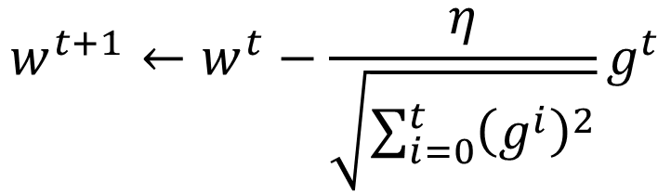


Contradiction?
$$η^{t}=\frac{η}{\sqrt{t+1}}$$
$$g^{t}=\frac{∂L\left(θ^{t}\right)}{∂w}$$
Vanilla Gradient descent
Larger gradient,
larger step
$$w^{t+1}←w^{t}−{\text{η}}^{t}g^{t}$$
Adagrad
Larger gradient,
larger step
$$w^{t+1}←w^{t}−\frac{η}{\sqrt{\sum_{i=0}^{t}{{\left(g^{i}\right)}^{2}}}}g^{t}$$
Larger gradient, smaller step
Notes:
Gradient Descent 梯度下降法
Stochastic 随机
Data normalization 数据归一化
Tuning your learning rates 调整学习率
Learning Rate 如果刚刚好，Learning Rate 顺着红色箭头走到最低点
Learning Rate 如果太小，步伐太小，如蓝色箭头所示，虽然也会走到最低点，但是速度会很慢
Learning Rate 如果太大，步伐太大，如绿色箭头所示，那么就走不到最低点，它永远在最低点两边震荡
Learning Rate 如果特别大，步伐特别大，如黄色箭头所示，那么参数就会越来越大，永远不能到达最低点
Adaptive Learning Rates 自适应学习率
Popular & Simple Idea: Reduce the learning rate by some factor every few epochs. 流行和简单的想法：每隔几个epoch就减少一些学习率。
At the beginning, we are far from the destination, so we use larger learning rate 一开始，我们离目的地很远，所以我们使用较大的学习率
After several epochs, we are close to the destination, so we reduce the learning rate 经过几个epoch之后，我们接近了目的地，所以我们降低了学习率
E.g. 1/t decay: 𝜂^𝑡=𝜂∕√(𝑡+1) 1/t衰变
Learning rate cannot be one-size-fits-all 学习率不可能是放之四海而皆准的
Giving different parameters different learning rates 给出不同的参数不同的学习率
Adagrad
Stochastic Gradient descent 随机
Vanilla Gradient descent
Contradiction 矛盾
Feature Scaling 特征缩放
Theory 理论

Slide 11
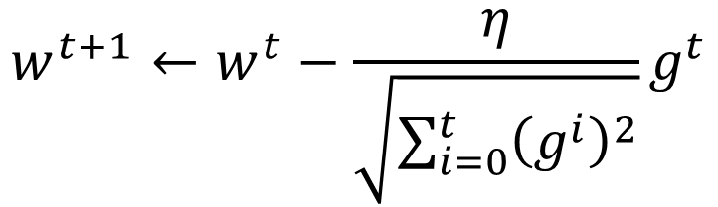


Intuitive Reason
$$η^{t}=\frac{η}{\sqrt{t+1}}$$
$$g^{t}=\frac{∂L\left(θ^{t}\right)}{∂w}$$
How surprise it is
反差
特別大
g⁰ | g¹ | g² | g³ | g⁴ | ……
0.001 | 0.001 | 0.003 | 0.002 | 0.1 | ……
g⁰ | g¹ | g² | g³ | g⁴ | ……
10.8 | 20.9 | 31.7 | 12.1 | 0.1 | ……
特別小
$$w^{t+1}←w^{t}−\frac{η}{\sqrt{\sum_{i=0}^{t}{{\left(g^{i}\right)}^{2}}}}g^{t}$$
造成反差的效果
Notes:
Gradient Descent 梯度下降法
Stochastic 随机
Data normalization 数据归一化
Tuning your learning rates 调整学习率
Learning Rate 如果刚刚好，Learning Rate 顺着红色箭头走到最低点
Learning Rate 如果太小，步伐太小，如蓝色箭头所示，虽然也会走到最低点，但是速度会很慢
Learning Rate 如果太大，步伐太大，如绿色箭头所示，那么就走不到最低点，它永远在最低点两边震荡
Learning Rate 如果特别大，步伐特别大，如黄色箭头所示，那么参数就会越来越大，永远不能到达最低点
Adaptive Learning Rates 自适应学习率
Popular & Simple Idea: Reduce the learning rate by some factor every few epochs. 流行和简单的想法：每隔几个epoch就减少一些学习率。
At the beginning, we are far from the destination, so we use larger learning rate 一开始，我们离目的地很远，所以我们使用较大的学习率
After several epochs, we are close to the destination, so we reduce the learning rate 经过几个epoch之后，我们接近了目的地，所以我们降低了学习率
E.g. 1/t decay: 𝜂^𝑡=𝜂∕√(𝑡+1) 1/t衰变
Learning rate cannot be one-size-fits-all 学习率不可能是放之四海而皆准的
Giving different parameters different learning rates 给出不同的参数不同的学习率
Adagrad
Stochastic Gradient descent 随机
Vanilla Gradient descent
Contradiction 矛盾
Intuitive Reason 直观的原因
http://seed.ucsd.edu/mediawiki/images/6/6a/Adagrad.pdf
http://courses.cs.washington.edu/courses/cse547/15sp/slides/adagrad.pdf
Some features can be extremely useful and informative to an optimization problem but they may not show up in most of the training instances or data. If, when they do show up, they are weighted equally in terms of learning rate as a feature that has shown up hundreds of times we are practically saying that the influence of such features means nothing in the overall optimization (it's impact per step in the stochastic gradient descent will be so small that it can practically be discounted). To counter this, AdaGrad makes it such that features that are more sparse in the data have a higher learning rate which translates into a larger update for that feature (i.e. in logistic regression that feature's regression coefficient will be increased/decreased more than a coefficient of a feature that is seen very often). 有些特征可能对优化问题非常有用，但它们可能不会出现在大多数训练实例或数据中。如果，当它们确实出现时，它们在学习率方面的权重是相等的，作为一个出现了数百次的特征，我们实际上是在说，这些特征的影响在整体优化中没有任何意义（它在随机梯度下降中的每一步的影响将非常小，几乎可以被贴现）。为了解决这个问题，AdaGrad使数据中更稀疏的特征具有更高的学习率，从而转化为该特征的更大更新（例如，在逻辑回归中，特征的回归系数将比经常看到的特征的系数增加/减少更多）。
Simply put, sparse features can be very useful. I don't have an example of application in neural network training. Different adaptive learning algorithms are useful with different data (it would really depend on what your data is and how much importance you place on sparse features). 简单地说，稀疏特征非常有用。我没有一个应用在神经网络训练中的例子。不同的自适应学习算法对不同的数据有用（这实际上取决于你的数据是什么以及你对稀疏特征的重视程度）。
Feature Scaling 特征缩放
Theory 理论

Slide 12
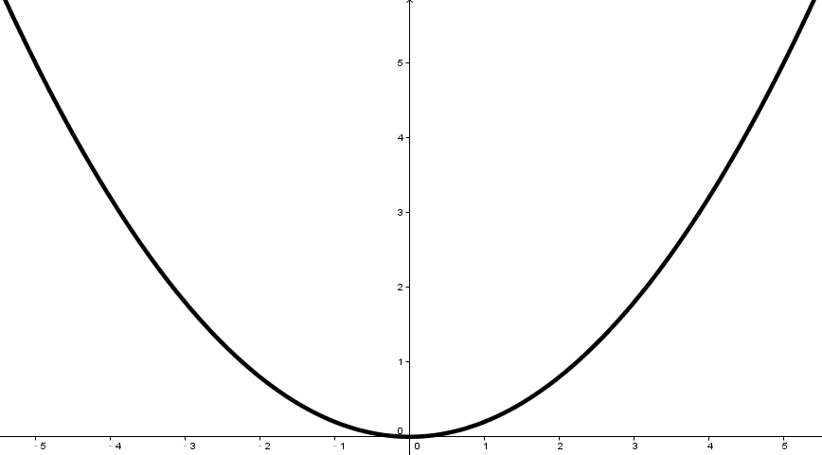
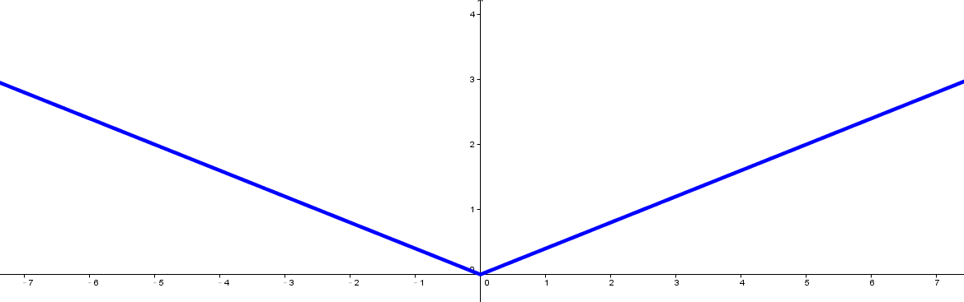


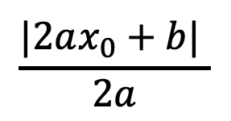





Larger gradient, larger steps?
Best step:
$$|x_{0}+\frac{b}{2a}|$$
$$\frac{|2ax_{0}+b| }{2a}$$
Larger 1st order derivative means far from the minima
$$x_{0}$$
$$−\frac{b}{2a}$$
$$y=ax^{2}+bx+c$$
$$|2ax_{0}+b|$$
$$\left|\frac{∂y}{∂x}\right|=|2ax+b|$$
$$x_{0}$$
Notes:
Gradient Descent 梯度下降法
Stochastic 随机
Data normalization 数据归一化
Tuning your learning rates 调整学习率
Learning Rate 如果刚刚好，Learning Rate 顺着红色箭头走到最低点
Learning Rate 如果太小，步伐太小，如蓝色箭头所示，虽然也会走到最低点，但是速度会很慢
Learning Rate 如果太大，步伐太大，如绿色箭头所示，那么就走不到最低点，它永远在最低点两边震荡
Learning Rate 如果特别大，步伐特别大，如黄色箭头所示，那么参数就会越来越大，永远不能到达最低点
Adaptive Learning Rates 自适应学习率
Popular & Simple Idea: Reduce the learning rate by some factor every few epochs. 流行和简单的想法：每隔几个epoch就减少一些学习率。
At the beginning, we are far from the destination, so we use larger learning rate 一开始，我们离目的地很远，所以我们使用较大的学习率
After several epochs, we are close to the destination, so we reduce the learning rate 经过几个epoch之后，我们接近了目的地，所以我们降低了学习率
E.g. 1/t decay: 𝜂^𝑡=𝜂∕√(𝑡+1) 1/t衰变
Learning rate cannot be one-size-fits-all 学习率不可能是放之四海而皆准的
Giving different parameters different learning rates 给出不同的参数不同的学习率
Adagrad
Stochastic Gradient descent 随机
Vanilla Gradient descent
Contradiction 矛盾
Intuitive Reason 直观的原因
http://seed.ucsd.edu/mediawiki/images/6/6a/Adagrad.pdf
http://courses.cs.washington.edu/courses/cse547/15sp/slides/adagrad.pdf
Some features can be extremely useful and informative to an optimization problem but they may not show up in most of the training instances or data. If, when they do show up, they are weighted equally in terms of learning rate as a feature that has shown up hundreds of times we are practically saying that the influence of such features means nothing in the overall optimization (it's impact per step in the stochastic gradient descent will be so small that it can practically be discounted). To counter this, AdaGrad makes it such that features that are more sparse in the data have a higher learning rate which translates into a larger update for that feature (i.e. in logistic regression that feature's regression coefficient will be increased/decreased more than a coefficient of a feature that is seen very often). 有些特征可能对优化问题非常有用，但它们可能不会出现在大多数训练实例或数据中。如果，当它们确实出现时，它们在学习率方面的权重是相等的，作为一个出现了数百次的特征，我们实际上是在说，这些特征的影响在整体优化中没有任何意义（它在随机梯度下降中的每一步的影响将非常小，几乎可以被贴现）。为了解决这个问题，AdaGrad使数据中更稀疏的特征具有更高的学习率，从而转化为该特征的更大更新（例如，在逻辑回归中，特征的回归系数将比经常看到的特征的系数增加/减少更多）。
Simply put, sparse features can be very useful. I don't have an example of application in neural network training. Different adaptive learning algorithms are useful with different data (it would really depend on what your data is and how much importance you place on sparse features). 简单地说，稀疏特征非常有用。我没有一个应用在神经网络训练中的例子。不同的自适应学习算法对不同的数据有用（这实际上取决于你的数据是什么以及你对稀疏特征的重视程度）。
Feature Scaling 特征缩放
Theory 理论

Slide 13
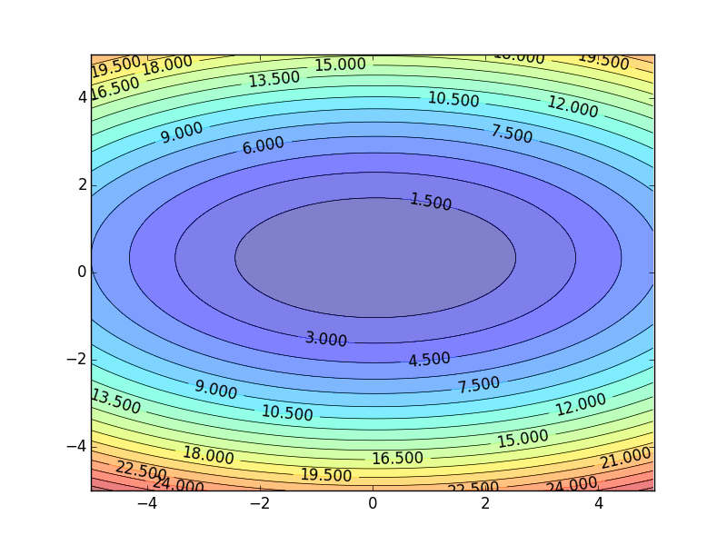
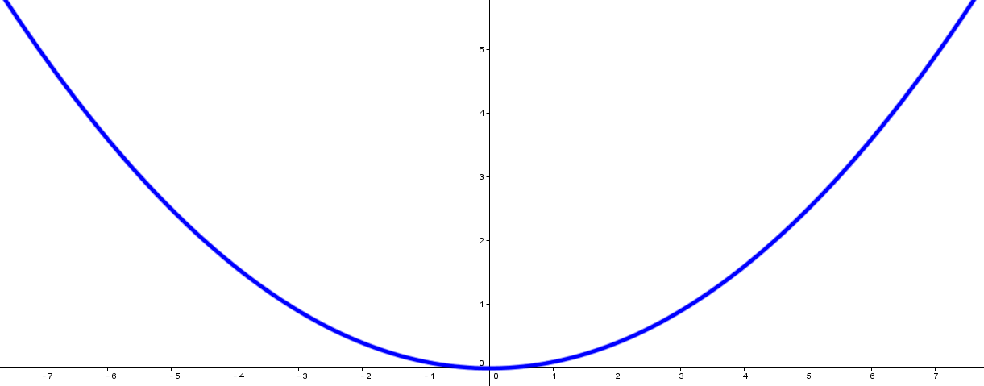
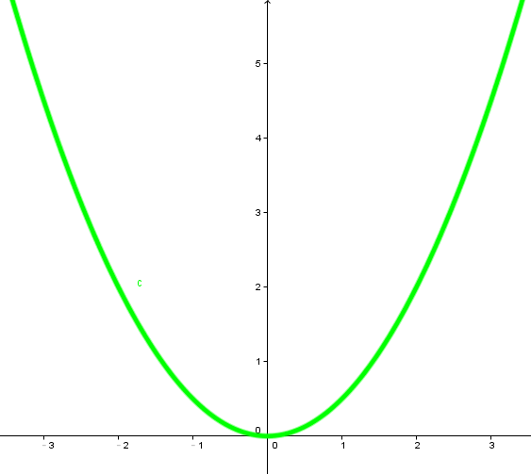




Comparison between different parameters
Larger 1st order derivative means far from the minima
Do not cross parameters
a > b
a
b
$$w_{1}$$
$$w_{2}$$
c
c > d
d
$$w_{1}$$
$$w_{2}$$
Notes:
Gradient Descent 梯度下降法
Stochastic 随机
Data normalization 数据归一化
Tuning your learning rates 调整学习率
Learning Rate 如果刚刚好，Learning Rate 顺着红色箭头走到最低点
Learning Rate 如果太小，步伐太小，如蓝色箭头所示，虽然也会走到最低点，但是速度会很慢
Learning Rate 如果太大，步伐太大，如绿色箭头所示，那么就走不到最低点，它永远在最低点两边震荡
Learning Rate 如果特别大，步伐特别大，如黄色箭头所示，那么参数就会越来越大，永远不能到达最低点
Adaptive Learning Rates 自适应学习率
Popular & Simple Idea: Reduce the learning rate by some factor every few epochs. 流行和简单的想法：每隔几个epoch就减少一些学习率。
At the beginning, we are far from the destination, so we use larger learning rate 一开始，我们离目的地很远，所以我们使用较大的学习率
After several epochs, we are close to the destination, so we reduce the learning rate 经过几个epoch之后，我们接近了目的地，所以我们降低了学习率
E.g. 1/t decay: 𝜂^𝑡=𝜂∕√(𝑡+1) 1/t衰变
Learning rate cannot be one-size-fits-all 学习率不可能是放之四海而皆准的
Giving different parameters different learning rates 给出不同的参数不同的学习率
Adagrad
Stochastic Gradient descent 随机
Vanilla Gradient descent
Contradiction 矛盾
Intuitive Reason 直观的原因
http://seed.ucsd.edu/mediawiki/images/6/6a/Adagrad.pdf
http://courses.cs.washington.edu/courses/cse547/15sp/slides/adagrad.pdf
Some features can be extremely useful and informative to an optimization problem but they may not show up in most of the training instances or data. If, when they do show up, they are weighted equally in terms of learning rate as a feature that has shown up hundreds of times we are practically saying that the influence of such features means nothing in the overall optimization (it's impact per step in the stochastic gradient descent will be so small that it can practically be discounted). To counter this, AdaGrad makes it such that features that are more sparse in the data have a higher learning rate which translates into a larger update for that feature (i.e. in logistic regression that feature's regression coefficient will be increased/decreased more than a coefficient of a feature that is seen very often). 有些特征可能对优化问题非常有用，但它们可能不会出现在大多数训练实例或数据中。如果，当它们确实出现时，它们在学习率方面的权重是相等的，作为一个出现了数百次的特征，我们实际上是在说，这些特征的影响在整体优化中没有任何意义（它在随机梯度下降中的每一步的影响将非常小，几乎可以被贴现）。为了解决这个问题，AdaGrad使数据中更稀疏的特征具有更高的学习率，从而转化为该特征的更大更新（例如，在逻辑回归中，特征的回归系数将比经常看到的特征的系数增加/减少更多）。
Simply put, sparse features can be very useful. I don't have an example of application in neural network training. Different adaptive learning algorithms are useful with different data (it would really depend on what your data is and how much importance you place on sparse features). 简单地说，稀疏特征非常有用。我没有一个应用在神经网络训练中的例子。不同的自适应学习算法对不同的数据有用（这实际上取决于你的数据是什么以及你对稀疏特征的重视程度）。
Comparison between different parameters 不同参数比较
Feature Scaling 特征缩放
Theory 理论

Slide 14

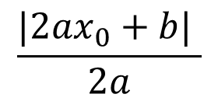

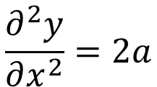





Second Derivative
Best step:
$$|x_{0}+\frac{b}{2a}|$$
$$\frac{|2ax_{0}+b| }{2a}$$
$$−\frac{b}{2a}$$
$$x_{0}$$
$$y=ax^{2}+bx+c$$
$$|2ax_{0}+b|$$
$$\left|\frac{∂y}{∂x}\right|=|2ax+b|$$
$$x_{0}$$
$$\frac{∂^{2}y}{∂x^{2}}=2a$$
|First derivative|
The best step is
Second derivative
Notes:
Gradient Descent 梯度下降法
Stochastic 随机
Data normalization 数据归一化
Tuning your learning rates 调整学习率
Learning Rate 如果刚刚好，Learning Rate 顺着红色箭头走到最低点
Learning Rate 如果太小，步伐太小，如蓝色箭头所示，虽然也会走到最低点，但是速度会很慢
Learning Rate 如果太大，步伐太大，如绿色箭头所示，那么就走不到最低点，它永远在最低点两边震荡
Learning Rate 如果特别大，步伐特别大，如黄色箭头所示，那么参数就会越来越大，永远不能到达最低点
Adaptive Learning Rates 自适应学习率
Popular & Simple Idea: Reduce the learning rate by some factor every few epochs. 流行和简单的想法：每隔几个epoch就减少一些学习率。
At the beginning, we are far from the destination, so we use larger learning rate 一开始，我们离目的地很远，所以我们使用较大的学习率
After several epochs, we are close to the destination, so we reduce the learning rate 经过几个epoch之后，我们接近了目的地，所以我们降低了学习率
E.g. 1/t decay: 𝜂^𝑡=𝜂∕√(𝑡+1) 1/t衰变
Learning rate cannot be one-size-fits-all 学习率不可能是放之四海而皆准的
Giving different parameters different learning rates 给出不同的参数不同的学习率
Adagrad
Stochastic Gradient descent 随机
Vanilla Gradient descent
Contradiction 矛盾
Intuitive Reason 直观的原因
http://seed.ucsd.edu/mediawiki/images/6/6a/Adagrad.pdf
http://courses.cs.washington.edu/courses/cse547/15sp/slides/adagrad.pdf
Some features can be extremely useful and informative to an optimization problem but they may not show up in most of the training instances or data. If, when they do show up, they are weighted equally in terms of learning rate as a feature that has shown up hundreds of times we are practically saying that the influence of such features means nothing in the overall optimization (it's impact per step in the stochastic gradient descent will be so small that it can practically be discounted). To counter this, AdaGrad makes it such that features that are more sparse in the data have a higher learning rate which translates into a larger update for that feature (i.e. in logistic regression that feature's regression coefficient will be increased/decreased more than a coefficient of a feature that is seen very often). 有些特征可能对优化问题非常有用，但它们可能不会出现在大多数训练实例或数据中。如果，当它们确实出现时，它们在学习率方面的权重是相等的，作为一个出现了数百次的特征，我们实际上是在说，这些特征的影响在整体优化中没有任何意义（它在随机梯度下降中的每一步的影响将非常小，几乎可以被贴现）。为了解决这个问题，AdaGrad使数据中更稀疏的特征具有更高的学习率，从而转化为该特征的更大更新（例如，在逻辑回归中，特征的回归系数将比经常看到的特征的系数增加/减少更多）。
Simply put, sparse features can be very useful. I don't have an example of application in neural network training. Different adaptive learning algorithms are useful with different data (it would really depend on what your data is and how much importance you place on sparse features). 简单地说，稀疏特征非常有用。我没有一个应用在神经网络训练中的例子。不同的自适应学习算法对不同的数据有用（这实际上取决于你的数据是什么以及你对稀疏特征的重视程度）。
Comparison between different parameters 不同参数比较
Second Derivative二阶导数
Feature Scaling 特征缩放
Theory 理论

Slide 15
Comparison between different parameters
Larger 1st order derivative means far from the minima
Do not cross parameters
|First derivative|
The best step is
Second derivative
a > b
Larger
Second
a
b
$$w_{1}$$
smaller second derivative
$$w_{2}$$
c
c > d
Smaller
Second
d
$$w_{1}$$
$$w_{2}$$
Larger second derivative
Notes:
Gradient Descent 梯度下降法
Stochastic 随机
Data normalization 数据归一化
Tuning your learning rates 调整学习率
Learning Rate 如果刚刚好，Learning Rate 顺着红色箭头走到最低点
Learning Rate 如果太小，步伐太小，如蓝色箭头所示，虽然也会走到最低点，但是速度会很慢
Learning Rate 如果太大，步伐太大，如绿色箭头所示，那么就走不到最低点，它永远在最低点两边震荡
Learning Rate 如果特别大，步伐特别大，如黄色箭头所示，那么参数就会越来越大，永远不能到达最低点
Adaptive Learning Rates 自适应学习率
Popular & Simple Idea: Reduce the learning rate by some factor every few epochs. 流行和简单的想法：每隔几个epoch就减少一些学习率。
At the beginning, we are far from the destination, so we use larger learning rate 一开始，我们离目的地很远，所以我们使用较大的学习率
After several epochs, we are close to the destination, so we reduce the learning rate 经过几个epoch之后，我们接近了目的地，所以我们降低了学习率
E.g. 1/t decay: 𝜂^𝑡=𝜂∕√(𝑡+1) 1/t衰变
Learning rate cannot be one-size-fits-all 学习率不可能是放之四海而皆准的
Giving different parameters different learning rates 给出不同的参数不同的学习率
Adagrad
Stochastic Gradient descent 随机
Vanilla Gradient descent
Contradiction 矛盾
Intuitive Reason 直观的原因
http://seed.ucsd.edu/mediawiki/images/6/6a/Adagrad.pdf
http://courses.cs.washington.edu/courses/cse547/15sp/slides/adagrad.pdf
Some features can be extremely useful and informative to an optimization problem but they may not show up in most of the training instances or data. If, when they do show up, they are weighted equally in terms of learning rate as a feature that has shown up hundreds of times we are practically saying that the influence of such features means nothing in the overall optimization (it's impact per step in the stochastic gradient descent will be so small that it can practically be discounted). To counter this, AdaGrad makes it such that features that are more sparse in the data have a higher learning rate which translates into a larger update for that feature (i.e. in logistic regression that feature's regression coefficient will be increased/decreased more than a coefficient of a feature that is seen very often). 有些特征可能对优化问题非常有用，但它们可能不会出现在大多数训练实例或数据中。如果，当它们确实出现时，它们在学习率方面的权重是相等的，作为一个出现了数百次的特征，我们实际上是在说，这些特征的影响在整体优化中没有任何意义（它在随机梯度下降中的每一步的影响将非常小，几乎可以被贴现）。为了解决这个问题，AdaGrad使数据中更稀疏的特征具有更高的学习率，从而转化为该特征的更大更新（例如，在逻辑回归中，特征的回归系数将比经常看到的特征的系数增加/减少更多）。
Simply put, sparse features can be very useful. I don't have an example of application in neural network training. Different adaptive learning algorithms are useful with different data (it would really depend on what your data is and how much importance you place on sparse features). 简单地说，稀疏特征非常有用。我没有一个应用在神经网络训练中的例子。不同的自适应学习算法对不同的数据有用（这实际上取决于你的数据是什么以及你对稀疏特征的重视程度）。
Comparison between different parameters 不同参数比较
Second Derivative二阶导数
Feature Scaling 特征缩放
Theory 理论

Slide 16
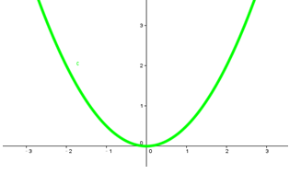
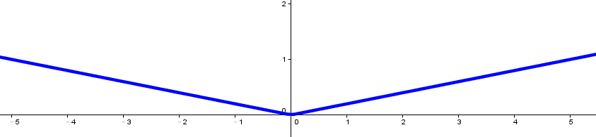
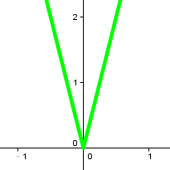


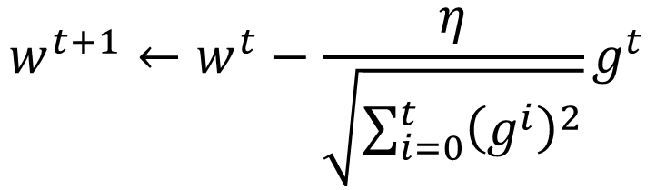

The best step is
$$w^{t+1}←w^{t}−\frac{η}{\sqrt{\sum_{i=0}^{t}{{\left(g^{i}\right)}^{2}}}}g^{t}$$
|First derivative|
Second derivative
?
Use first derivative to estimate second derivative
larger second derivative
smaller second derivative
$$w_{1}$$
$$w_{2}$$
$$\sqrt{{\left(first derivative\right)}^{2}}$$
Notes:
Gradient Descent 梯度下降法
Stochastic 随机
Data normalization 数据归一化
Tuning your learning rates 调整学习率
Learning Rate 如果刚刚好，Learning Rate 顺着红色箭头走到最低点
Learning Rate 如果太小，步伐太小，如蓝色箭头所示，虽然也会走到最低点，但是速度会很慢
Learning Rate 如果太大，步伐太大，如绿色箭头所示，那么就走不到最低点，它永远在最低点两边震荡
Learning Rate 如果特别大，步伐特别大，如黄色箭头所示，那么参数就会越来越大，永远不能到达最低点
Adaptive Learning Rates 自适应学习率
Popular & Simple Idea: Reduce the learning rate by some factor every few epochs. 流行和简单的想法：每隔几个epoch就减少一些学习率。
At the beginning, we are far from the destination, so we use larger learning rate 一开始，我们离目的地很远，所以我们使用较大的学习率
After several epochs, we are close to the destination, so we reduce the learning rate 经过几个epoch之后，我们接近了目的地，所以我们降低了学习率
E.g. 1/t decay: 𝜂^𝑡=𝜂∕√(𝑡+1) 1/t衰变
Learning rate cannot be one-size-fits-all 学习率不可能是放之四海而皆准的
Giving different parameters different learning rates 给出不同的参数不同的学习率
Adagrad
Stochastic Gradient descent 随机
Vanilla Gradient descent
Contradiction 矛盾
Intuitive Reason 直观的原因
http://seed.ucsd.edu/mediawiki/images/6/6a/Adagrad.pdf
http://courses.cs.washington.edu/courses/cse547/15sp/slides/adagrad.pdf
Some features can be extremely useful and informative to an optimization problem but they may not show up in most of the training instances or data. If, when they do show up, they are weighted equally in terms of learning rate as a feature that has shown up hundreds of times we are practically saying that the influence of such features means nothing in the overall optimization (it's impact per step in the stochastic gradient descent will be so small that it can practically be discounted). To counter this, AdaGrad makes it such that features that are more sparse in the data have a higher learning rate which translates into a larger update for that feature (i.e. in logistic regression that feature's regression coefficient will be increased/decreased more than a coefficient of a feature that is seen very often). 有些特征可能对优化问题非常有用，但它们可能不会出现在大多数训练实例或数据中。如果，当它们确实出现时，它们在学习率方面的权重是相等的，作为一个出现了数百次的特征，我们实际上是在说，这些特征的影响在整体优化中没有任何意义（它在随机梯度下降中的每一步的影响将非常小，几乎可以被贴现）。为了解决这个问题，AdaGrad使数据中更稀疏的特征具有更高的学习率，从而转化为该特征的更大更新（例如，在逻辑回归中，特征的回归系数将比经常看到的特征的系数增加/减少更多）。
Simply put, sparse features can be very useful. I don't have an example of application in neural network training. Different adaptive learning algorithms are useful with different data (it would really depend on what your data is and how much importance you place on sparse features). 简单地说，稀疏特征非常有用。我没有一个应用在神经网络训练中的例子。不同的自适应学习算法对不同的数据有用（这实际上取决于你的数据是什么以及你对稀疏特征的重视程度）。
Comparison between different parameters 不同参数比较
Second Derivative二阶导数
Feature Scaling 特征缩放
Theory 理论

Slide 17
Gradient Descent
Tip 2: Stochastic
Gradient Descent
Make the training faster
Notes:
Gradient Descent 梯度下降法
Stochastic 随机
Data normalization 数据归一化
Tuning your learning rates 调整学习率
Learning Rate 如果刚刚好，Learning Rate 顺着红色箭头走到最低点
Learning Rate 如果太小，步伐太小，如蓝色箭头所示，虽然也会走到最低点，但是速度会很慢
Learning Rate 如果太大，步伐太大，如绿色箭头所示，那么就走不到最低点，它永远在最低点两边震荡
Learning Rate 如果特别大，步伐特别大，如黄色箭头所示，那么参数就会越来越大，永远不能到达最低点
Adaptive Learning Rates 自适应学习率
Popular & Simple Idea: Reduce the learning rate by some factor every few epochs. 流行和简单的想法：每隔几个epoch就减少一些学习率。
At the beginning, we are far from the destination, so we use larger learning rate 一开始，我们离目的地很远，所以我们使用较大的学习率
After several epochs, we are close to the destination, so we reduce the learning rate 经过几个epoch之后，我们接近了目的地，所以我们降低了学习率
E.g. 1/t decay: 𝜂^𝑡=𝜂∕√(𝑡+1) 1/t衰变
Learning rate cannot be one-size-fits-all 学习率不可能是放之四海而皆准的
Giving different parameters different learning rates 给出不同的参数不同的学习率
Adagrad
Stochastic Gradient descent 随机
Vanilla Gradient descent
Contradiction 矛盾
Intuitive Reason 直观的原因
http://seed.ucsd.edu/mediawiki/images/6/6a/Adagrad.pdf
http://courses.cs.washington.edu/courses/cse547/15sp/slides/adagrad.pdf
Some features can be extremely useful and informative to an optimization problem but they may not show up in most of the training instances or data. If, when they do show up, they are weighted equally in terms of learning rate as a feature that has shown up hundreds of times we are practically saying that the influence of such features means nothing in the overall optimization (it's impact per step in the stochastic gradient descent will be so small that it can practically be discounted). To counter this, AdaGrad makes it such that features that are more sparse in the data have a higher learning rate which translates into a larger update for that feature (i.e. in logistic regression that feature's regression coefficient will be increased/decreased more than a coefficient of a feature that is seen very often). 有些特征可能对优化问题非常有用，但它们可能不会出现在大多数训练实例或数据中。如果，当它们确实出现时，它们在学习率方面的权重是相等的，作为一个出现了数百次的特征，我们实际上是在说，这些特征的影响在整体优化中没有任何意义（它在随机梯度下降中的每一步的影响将非常小，几乎可以被贴现）。为了解决这个问题，AdaGrad使数据中更稀疏的特征具有更高的学习率，从而转化为该特征的更大更新（例如，在逻辑回归中，特征的回归系数将比经常看到的特征的系数增加/减少更多）。
Simply put, sparse features can be very useful. I don't have an example of application in neural network training. Different adaptive learning algorithms are useful with different data (it would really depend on what your data is and how much importance you place on sparse features). 简单地说，稀疏特征非常有用。我没有一个应用在神经网络训练中的例子。不同的自适应学习算法对不同的数据有用（这实际上取决于你的数据是什么以及你对稀疏特征的重视程度）。
Comparison between different parameters 不同参数比较
Second Derivative二阶导数
Stochastic Gradient descent 随机
Feature Scaling 特征缩放
Theory 理论

Slide 18


Stochastic Gradient Descent
$$L=\sum_{n}{{\left({\hat{y}}^{n}−\left(b+ \sum{w_{i}x_{i}^{n}}\right)\right)}^{2}}$$
Loss is the summation over all training examples
Gradient Descent
Stochastic Gradient Descent
Faster!
Pick an example x^{n}
$$L^{n}={\left({\hat{y}}^{n}−\left(b+ \sum{w_{i}x_{i}^{n}}\right)\right)}^{2}$$
Loss for only one example
Notes:
Gradient Descent 梯度下降法
Stochastic 随机
Data normalization 数据归一化
Tuning your learning rates 调整学习率
Learning Rate 如果刚刚好，Learning Rate 顺着红色箭头走到最低点
Learning Rate 如果太小，步伐太小，如蓝色箭头所示，虽然也会走到最低点，但是速度会很慢
Learning Rate 如果太大，步伐太大，如绿色箭头所示，那么就走不到最低点，它永远在最低点两边震荡
Learning Rate 如果特别大，步伐特别大，如黄色箭头所示，那么参数就会越来越大，永远不能到达最低点
Adaptive Learning Rates 自适应学习率
Popular & Simple Idea: Reduce the learning rate by some factor every few epochs. 流行和简单的想法：每隔几个epoch就减少一些学习率。
At the beginning, we are far from the destination, so we use larger learning rate 一开始，我们离目的地很远，所以我们使用较大的学习率
After several epochs, we are close to the destination, so we reduce the learning rate 经过几个epoch之后，我们接近了目的地，所以我们降低了学习率
E.g. 1/t decay: 𝜂^𝑡=𝜂∕√(𝑡+1) 1/t衰变
Learning rate cannot be one-size-fits-all 学习率不可能是放之四海而皆准的
Giving different parameters different learning rates 给出不同的参数不同的学习率
Adagrad
Stochastic Gradient descent 随机
Vanilla Gradient descent
Contradiction 矛盾
Intuitive Reason 直观的原因
http://seed.ucsd.edu/mediawiki/images/6/6a/Adagrad.pdf
http://courses.cs.washington.edu/courses/cse547/15sp/slides/adagrad.pdf
Some features can be extremely useful and informative to an optimization problem but they may not show up in most of the training instances or data. If, when they do show up, they are weighted equally in terms of learning rate as a feature that has shown up hundreds of times we are practically saying that the influence of such features means nothing in the overall optimization (it's impact per step in the stochastic gradient descent will be so small that it can practically be discounted). To counter this, AdaGrad makes it such that features that are more sparse in the data have a higher learning rate which translates into a larger update for that feature (i.e. in logistic regression that feature's regression coefficient will be increased/decreased more than a coefficient of a feature that is seen very often). 有些特征可能对优化问题非常有用，但它们可能不会出现在大多数训练实例或数据中。如果，当它们确实出现时，它们在学习率方面的权重是相等的，作为一个出现了数百次的特征，我们实际上是在说，这些特征的影响在整体优化中没有任何意义（它在随机梯度下降中的每一步的影响将非常小，几乎可以被贴现）。为了解决这个问题，AdaGrad使数据中更稀疏的特征具有更高的学习率，从而转化为该特征的更大更新（例如，在逻辑回归中，特征的回归系数将比经常看到的特征的系数增加/减少更多）。
Simply put, sparse features can be very useful. I don't have an example of application in neural network training. Different adaptive learning algorithms are useful with different data (it would really depend on what your data is and how much importance you place on sparse features). 简单地说，稀疏特征非常有用。我没有一个应用在神经网络训练中的例子。不同的自适应学习算法对不同的数据有用（这实际上取决于你的数据是什么以及你对稀疏特征的重视程度）。
Comparison between different parameters 不同参数比较
Second Derivative二阶导数
Stochastic Gradient descent 随机
Two approaches update the parameters towards the same direction, but stochastic is faster!
Feature Scaling 特征缩放
Theory 理论

Slide 19
Demo
Notes:
Gradient Descent 梯度下降法
Stochastic 随机
Data normalization 数据归一化
Tuning your learning rates 调整学习率
Learning Rate 如果刚刚好，Learning Rate 顺着红色箭头走到最低点
Learning Rate 如果太小，步伐太小，如蓝色箭头所示，虽然也会走到最低点，但是速度会很慢
Learning Rate 如果太大，步伐太大，如绿色箭头所示，那么就走不到最低点，它永远在最低点两边震荡
Learning Rate 如果特别大，步伐特别大，如黄色箭头所示，那么参数就会越来越大，永远不能到达最低点
Adaptive Learning Rates 自适应学习率
Popular & Simple Idea: Reduce the learning rate by some factor every few epochs. 流行和简单的想法：每隔几个epoch就减少一些学习率。
At the beginning, we are far from the destination, so we use larger learning rate 一开始，我们离目的地很远，所以我们使用较大的学习率
After several epochs, we are close to the destination, so we reduce the learning rate 经过几个epoch之后，我们接近了目的地，所以我们降低了学习率
E.g. 1/t decay: 𝜂^𝑡=𝜂∕√(𝑡+1) 1/t衰变
Learning rate cannot be one-size-fits-all 学习率不可能是放之四海而皆准的
Giving different parameters different learning rates 给出不同的参数不同的学习率
Adagrad
Stochastic Gradient descent 随机
Vanilla Gradient descent
Contradiction 矛盾
Intuitive Reason 直观的原因
http://seed.ucsd.edu/mediawiki/images/6/6a/Adagrad.pdf
http://courses.cs.washington.edu/courses/cse547/15sp/slides/adagrad.pdf
Some features can be extremely useful and informative to an optimization problem but they may not show up in most of the training instances or data. If, when they do show up, they are weighted equally in terms of learning rate as a feature that has shown up hundreds of times we are practically saying that the influence of such features means nothing in the overall optimization (it's impact per step in the stochastic gradient descent will be so small that it can practically be discounted). To counter this, AdaGrad makes it such that features that are more sparse in the data have a higher learning rate which translates into a larger update for that feature (i.e. in logistic regression that feature's regression coefficient will be increased/decreased more than a coefficient of a feature that is seen very often). 有些特征可能对优化问题非常有用，但它们可能不会出现在大多数训练实例或数据中。如果，当它们确实出现时，它们在学习率方面的权重是相等的，作为一个出现了数百次的特征，我们实际上是在说，这些特征的影响在整体优化中没有任何意义（它在随机梯度下降中的每一步的影响将非常小，几乎可以被贴现）。为了解决这个问题，AdaGrad使数据中更稀疏的特征具有更高的学习率，从而转化为该特征的更大更新（例如，在逻辑回归中，特征的回归系数将比经常看到的特征的系数增加/减少更多）。
Simply put, sparse features can be very useful. I don't have an example of application in neural network training. Different adaptive learning algorithms are useful with different data (it would really depend on what your data is and how much importance you place on sparse features). 简单地说，稀疏特征非常有用。我没有一个应用在神经网络训练中的例子。不同的自适应学习算法对不同的数据有用（这实际上取决于你的数据是什么以及你对稀疏特征的重视程度）。
Comparison between different parameters 不同参数比较
Second Derivative二阶导数
Stochastic Gradient descent 随机
Two approaches update the parameters towards the same direction, but stochastic is faster!
Feature Scaling 特征缩放
Theory 理论

Slide 20


Stochastic Gradient Descent
Stochastic Gradient Descent
Gradient Descent
Update for each example
Update after seeing all examples
If there are 20 examples,
20 times faster.
See all examples
See only one example
See all examples
Notes:
Gradient Descent 梯度下降法
Stochastic 随机
Data normalization 数据归一化
Tuning your learning rates 调整学习率
Learning Rate 如果刚刚好，Learning Rate 顺着红色箭头走到最低点
Learning Rate 如果太小，步伐太小，如蓝色箭头所示，虽然也会走到最低点，但是速度会很慢
Learning Rate 如果太大，步伐太大，如绿色箭头所示，那么就走不到最低点，它永远在最低点两边震荡
Learning Rate 如果特别大，步伐特别大，如黄色箭头所示，那么参数就会越来越大，永远不能到达最低点
Adaptive Learning Rates 自适应学习率
Popular & Simple Idea: Reduce the learning rate by some factor every few epochs. 流行和简单的想法：每隔几个epoch就减少一些学习率。
At the beginning, we are far from the destination, so we use larger learning rate 一开始，我们离目的地很远，所以我们使用较大的学习率
After several epochs, we are close to the destination, so we reduce the learning rate 经过几个epoch之后，我们接近了目的地，所以我们降低了学习率
E.g. 1/t decay: 𝜂^𝑡=𝜂∕√(𝑡+1) 1/t衰变
Learning rate cannot be one-size-fits-all 学习率不可能是放之四海而皆准的
Giving different parameters different learning rates 给出不同的参数不同的学习率
Adagrad
Stochastic Gradient descent 随机
Vanilla Gradient descent
Contradiction 矛盾
Intuitive Reason 直观的原因
http://seed.ucsd.edu/mediawiki/images/6/6a/Adagrad.pdf
http://courses.cs.washington.edu/courses/cse547/15sp/slides/adagrad.pdf
Some features can be extremely useful and informative to an optimization problem but they may not show up in most of the training instances or data. If, when they do show up, they are weighted equally in terms of learning rate as a feature that has shown up hundreds of times we are practically saying that the influence of such features means nothing in the overall optimization (it's impact per step in the stochastic gradient descent will be so small that it can practically be discounted). To counter this, AdaGrad makes it such that features that are more sparse in the data have a higher learning rate which translates into a larger update for that feature (i.e. in logistic regression that feature's regression coefficient will be increased/decreased more than a coefficient of a feature that is seen very often). 有些特征可能对优化问题非常有用，但它们可能不会出现在大多数训练实例或数据中。如果，当它们确实出现时，它们在学习率方面的权重是相等的，作为一个出现了数百次的特征，我们实际上是在说，这些特征的影响在整体优化中没有任何意义（它在随机梯度下降中的每一步的影响将非常小，几乎可以被贴现）。为了解决这个问题，AdaGrad使数据中更稀疏的特征具有更高的学习率，从而转化为该特征的更大更新（例如，在逻辑回归中，特征的回归系数将比经常看到的特征的系数增加/减少更多）。
Simply put, sparse features can be very useful. I don't have an example of application in neural network training. Different adaptive learning algorithms are useful with different data (it would really depend on what your data is and how much importance you place on sparse features). 简单地说，稀疏特征非常有用。我没有一个应用在神经网络训练中的例子。不同的自适应学习算法对不同的数据有用（这实际上取决于你的数据是什么以及你对稀疏特征的重视程度）。
Comparison between different parameters 不同参数比较
Second Derivative二阶导数
Stochastic Gradient descent 随机
Two approaches update the parameters towards the same direction, but stochastic is faster!
Feature Scaling 特征缩放
Theory 理论

Slide 21
Gradient Descent
Tip 3: Feature Scaling
Notes:
Gradient Descent 梯度下降法
Stochastic 随机
Data normalization 数据归一化
Tuning your learning rates 调整学习率
Learning Rate 如果刚刚好，Learning Rate 顺着红色箭头走到最低点
Learning Rate 如果太小，步伐太小，如蓝色箭头所示，虽然也会走到最低点，但是速度会很慢
Learning Rate 如果太大，步伐太大，如绿色箭头所示，那么就走不到最低点，它永远在最低点两边震荡
Learning Rate 如果特别大，步伐特别大，如黄色箭头所示，那么参数就会越来越大，永远不能到达最低点
Adaptive Learning Rates 自适应学习率
Popular & Simple Idea: Reduce the learning rate by some factor every few epochs. 流行和简单的想法：每隔几个epoch就减少一些学习率。
At the beginning, we are far from the destination, so we use larger learning rate 一开始，我们离目的地很远，所以我们使用较大的学习率
After several epochs, we are close to the destination, so we reduce the learning rate 经过几个epoch之后，我们接近了目的地，所以我们降低了学习率
E.g. 1/t decay: 𝜂^𝑡=𝜂∕√(𝑡+1) 1/t衰变
Learning rate cannot be one-size-fits-all 学习率不可能是放之四海而皆准的
Giving different parameters different learning rates 给出不同的参数不同的学习率
Adagrad
Stochastic Gradient descent 随机
Vanilla Gradient descent
Contradiction 矛盾
Intuitive Reason 直观的原因
http://seed.ucsd.edu/mediawiki/images/6/6a/Adagrad.pdf
http://courses.cs.washington.edu/courses/cse547/15sp/slides/adagrad.pdf
Some features can be extremely useful and informative to an optimization problem but they may not show up in most of the training instances or data. If, when they do show up, they are weighted equally in terms of learning rate as a feature that has shown up hundreds of times we are practically saying that the influence of such features means nothing in the overall optimization (it's impact per step in the stochastic gradient descent will be so small that it can practically be discounted). To counter this, AdaGrad makes it such that features that are more sparse in the data have a higher learning rate which translates into a larger update for that feature (i.e. in logistic regression that feature's regression coefficient will be increased/decreased more than a coefficient of a feature that is seen very often). 有些特征可能对优化问题非常有用，但它们可能不会出现在大多数训练实例或数据中。如果，当它们确实出现时，它们在学习率方面的权重是相等的，作为一个出现了数百次的特征，我们实际上是在说，这些特征的影响在整体优化中没有任何意义（它在随机梯度下降中的每一步的影响将非常小，几乎可以被贴现）。为了解决这个问题，AdaGrad使数据中更稀疏的特征具有更高的学习率，从而转化为该特征的更大更新（例如，在逻辑回归中，特征的回归系数将比经常看到的特征的系数增加/减少更多）。
Simply put, sparse features can be very useful. I don't have an example of application in neural network training. Different adaptive learning algorithms are useful with different data (it would really depend on what your data is and how much importance you place on sparse features). 简单地说，稀疏特征非常有用。我没有一个应用在神经网络训练中的例子。不同的自适应学习算法对不同的数据有用（这实际上取决于你的数据是什么以及你对稀疏特征的重视程度）。
Comparison between different parameters 不同参数比较
Second Derivative二阶导数
Stochastic Gradient descent 随机
Two approaches update the parameters towards the same direction, but stochastic is faster!
Feature Scaling 特征缩放
Theory 理论

Slide 22







Feature Scaling
Source of figure: http://cs231n.github.io/neural-networks-2/
$$y=b+w_{1}x_{1}+w_{2}x_{2}$$
$$x_{2}$$
$$x_{2}$$
$$x_{1}$$
$$x_{1}$$
Make different features have the same scaling
Notes:
Gradient Descent 梯度下降法
Stochastic 随机
Data normalization 数据归一化
Tuning your learning rates 调整学习率
Learning Rate 如果刚刚好，Learning Rate 顺着红色箭头走到最低点
Learning Rate 如果太小，步伐太小，如蓝色箭头所示，虽然也会走到最低点，但是速度会很慢
Learning Rate 如果太大，步伐太大，如绿色箭头所示，那么就走不到最低点，它永远在最低点两边震荡
Learning Rate 如果特别大，步伐特别大，如黄色箭头所示，那么参数就会越来越大，永远不能到达最低点
Adaptive Learning Rates 自适应学习率
Popular & Simple Idea: Reduce the learning rate by some factor every few epochs. 流行和简单的想法：每隔几个epoch就减少一些学习率。
At the beginning, we are far from the destination, so we use larger learning rate 一开始，我们离目的地很远，所以我们使用较大的学习率
After several epochs, we are close to the destination, so we reduce the learning rate 经过几个epoch之后，我们接近了目的地，所以我们降低了学习率
E.g. 1/t decay: 𝜂^𝑡=𝜂∕√(𝑡+1) 1/t衰变
Learning rate cannot be one-size-fits-all 学习率不可能是放之四海而皆准的
Giving different parameters different learning rates 给出不同的参数不同的学习率
Adagrad
Stochastic Gradient descent 随机
Vanilla Gradient descent
Contradiction 矛盾
Intuitive Reason 直观的原因
http://seed.ucsd.edu/mediawiki/images/6/6a/Adagrad.pdf
http://courses.cs.washington.edu/courses/cse547/15sp/slides/adagrad.pdf
Some features can be extremely useful and informative to an optimization problem but they may not show up in most of the training instances or data. If, when they do show up, they are weighted equally in terms of learning rate as a feature that has shown up hundreds of times we are practically saying that the influence of such features means nothing in the overall optimization (it's impact per step in the stochastic gradient descent will be so small that it can practically be discounted). To counter this, AdaGrad makes it such that features that are more sparse in the data have a higher learning rate which translates into a larger update for that feature (i.e. in logistic regression that feature's regression coefficient will be increased/decreased more than a coefficient of a feature that is seen very often). 有些特征可能对优化问题非常有用，但它们可能不会出现在大多数训练实例或数据中。如果，当它们确实出现时，它们在学习率方面的权重是相等的，作为一个出现了数百次的特征，我们实际上是在说，这些特征的影响在整体优化中没有任何意义（它在随机梯度下降中的每一步的影响将非常小，几乎可以被贴现）。为了解决这个问题，AdaGrad使数据中更稀疏的特征具有更高的学习率，从而转化为该特征的更大更新（例如，在逻辑回归中，特征的回归系数将比经常看到的特征的系数增加/减少更多）。
Simply put, sparse features can be very useful. I don't have an example of application in neural network training. Different adaptive learning algorithms are useful with different data (it would really depend on what your data is and how much importance you place on sparse features). 简单地说，稀疏特征非常有用。我没有一个应用在神经网络训练中的例子。不同的自适应学习算法对不同的数据有用（这实际上取决于你的数据是什么以及你对稀疏特征的重视程度）。
Comparison between different parameters 不同参数比较
Second Derivative二阶导数
Stochastic Gradient descent 随机
Two approaches update the parameters towards the same direction, but stochastic is faster!
Feature Scaling 特征缩放
Theory 理论

Slide 23

Feature Scaling
$$y=b+w_{1}x_{1}+w_{2}x_{2}$$
1, 2 ……
1, 2 ……
100, 200 ……
1, 2 ……
Loss L
Loss L
Notes:
Gradient Descent 梯度下降法
Stochastic 随机
Data normalization 数据归一化
Tuning your learning rates 调整学习率
Learning Rate 如果刚刚好，Learning Rate 顺着红色箭头走到最低点
Learning Rate 如果太小，步伐太小，如蓝色箭头所示，虽然也会走到最低点，但是速度会很慢
Learning Rate 如果太大，步伐太大，如绿色箭头所示，那么就走不到最低点，它永远在最低点两边震荡
Learning Rate 如果特别大，步伐特别大，如黄色箭头所示，那么参数就会越来越大，永远不能到达最低点
Adaptive Learning Rates 自适应学习率
Popular & Simple Idea: Reduce the learning rate by some factor every few epochs. 流行和简单的想法：每隔几个epoch就减少一些学习率。
At the beginning, we are far from the destination, so we use larger learning rate 一开始，我们离目的地很远，所以我们使用较大的学习率
After several epochs, we are close to the destination, so we reduce the learning rate 经过几个epoch之后，我们接近了目的地，所以我们降低了学习率
E.g. 1/t decay: 𝜂^𝑡=𝜂∕√(𝑡+1) 1/t衰变
Learning rate cannot be one-size-fits-all 学习率不可能是放之四海而皆准的
Giving different parameters different learning rates 给出不同的参数不同的学习率
Adagrad
Stochastic Gradient descent 随机
Vanilla Gradient descent
Contradiction 矛盾
Intuitive Reason 直观的原因
http://seed.ucsd.edu/mediawiki/images/6/6a/Adagrad.pdf
http://courses.cs.washington.edu/courses/cse547/15sp/slides/adagrad.pdf
Some features can be extremely useful and informative to an optimization problem but they may not show up in most of the training instances or data. If, when they do show up, they are weighted equally in terms of learning rate as a feature that has shown up hundreds of times we are practically saying that the influence of such features means nothing in the overall optimization (it's impact per step in the stochastic gradient descent will be so small that it can practically be discounted). To counter this, AdaGrad makes it such that features that are more sparse in the data have a higher learning rate which translates into a larger update for that feature (i.e. in logistic regression that feature's regression coefficient will be increased/decreased more than a coefficient of a feature that is seen very often). 有些特征可能对优化问题非常有用，但它们可能不会出现在大多数训练实例或数据中。如果，当它们确实出现时，它们在学习率方面的权重是相等的，作为一个出现了数百次的特征，我们实际上是在说，这些特征的影响在整体优化中没有任何意义（它在随机梯度下降中的每一步的影响将非常小，几乎可以被贴现）。为了解决这个问题，AdaGrad使数据中更稀疏的特征具有更高的学习率，从而转化为该特征的更大更新（例如，在逻辑回归中，特征的回归系数将比经常看到的特征的系数增加/减少更多）。
Simply put, sparse features can be very useful. I don't have an example of application in neural network training. Different adaptive learning algorithms are useful with different data (it would really depend on what your data is and how much importance you place on sparse features). 简单地说，稀疏特征非常有用。我没有一个应用在神经网络训练中的例子。不同的自适应学习算法对不同的数据有用（这实际上取决于你的数据是什么以及你对稀疏特征的重视程度）。
Comparison between different parameters 不同参数比较
Second Derivative二阶导数
Stochastic Gradient descent 随机
Two approaches update the parameters towards the same direction, but stochastic is faster!
Feature Scaling 特征缩放
Theory 理论

Slide 24












Feature Scaling
$$x^{1}$$
$$x^{2}$$
$$x^{3}$$
$$x^{r}$$
$$x^{R}$$
$$x_{1}^{1}$$
$$x_{1}^{2}$$
For each dimension i:
$$x_{2}^{1}$$
$$x_{2}^{2}$$
……
……
mean: $m_{i}$
……
……
……
……
……
standard deviation: $σ_{i}$
$$x_{i}^{r}←\frac{x_{i}^{r}−m_{i}}{σ_{i}}$$
The means of all dimensions are 0, and the variances are all 1
Notes:
Gradient Descent 梯度下降法
Stochastic 随机
Data normalization 数据归一化
Tuning your learning rates 调整学习率
Learning Rate 如果刚刚好，Learning Rate 顺着红色箭头走到最低点
Learning Rate 如果太小，步伐太小，如蓝色箭头所示，虽然也会走到最低点，但是速度会很慢
Learning Rate 如果太大，步伐太大，如绿色箭头所示，那么就走不到最低点，它永远在最低点两边震荡
Learning Rate 如果特别大，步伐特别大，如黄色箭头所示，那么参数就会越来越大，永远不能到达最低点
Adaptive Learning Rates 自适应学习率
Popular & Simple Idea: Reduce the learning rate by some factor every few epochs. 流行和简单的想法：每隔几个epoch就减少一些学习率。
At the beginning, we are far from the destination, so we use larger learning rate 一开始，我们离目的地很远，所以我们使用较大的学习率
After several epochs, we are close to the destination, so we reduce the learning rate 经过几个epoch之后，我们接近了目的地，所以我们降低了学习率
E.g. 1/t decay: 𝜂^𝑡=𝜂∕√(𝑡+1) 1/t衰变
Learning rate cannot be one-size-fits-all 学习率不可能是放之四海而皆准的
Giving different parameters different learning rates 给出不同的参数不同的学习率
Adagrad
Stochastic Gradient descent 随机
Vanilla Gradient descent
Contradiction 矛盾
Intuitive Reason 直观的原因
http://seed.ucsd.edu/mediawiki/images/6/6a/Adagrad.pdf
http://courses.cs.washington.edu/courses/cse547/15sp/slides/adagrad.pdf
Some features can be extremely useful and informative to an optimization problem but they may not show up in most of the training instances or data. If, when they do show up, they are weighted equally in terms of learning rate as a feature that has shown up hundreds of times we are practically saying that the influence of such features means nothing in the overall optimization (it's impact per step in the stochastic gradient descent will be so small that it can practically be discounted). To counter this, AdaGrad makes it such that features that are more sparse in the data have a higher learning rate which translates into a larger update for that feature (i.e. in logistic regression that feature's regression coefficient will be increased/decreased more than a coefficient of a feature that is seen very often). 有些特征可能对优化问题非常有用，但它们可能不会出现在大多数训练实例或数据中。如果，当它们确实出现时，它们在学习率方面的权重是相等的，作为一个出现了数百次的特征，我们实际上是在说，这些特征的影响在整体优化中没有任何意义（它在随机梯度下降中的每一步的影响将非常小，几乎可以被贴现）。为了解决这个问题，AdaGrad使数据中更稀疏的特征具有更高的学习率，从而转化为该特征的更大更新（例如，在逻辑回归中，特征的回归系数将比经常看到的特征的系数增加/减少更多）。
Simply put, sparse features can be very useful. I don't have an example of application in neural network training. Different adaptive learning algorithms are useful with different data (it would really depend on what your data is and how much importance you place on sparse features). 简单地说，稀疏特征非常有用。我没有一个应用在神经网络训练中的例子。不同的自适应学习算法对不同的数据有用（这实际上取决于你的数据是什么以及你对稀疏特征的重视程度）。
Comparison between different parameters 不同参数比较
Second Derivative二阶导数
Stochastic Gradient descent 随机
Two approaches update the parameters towards the same direction, but stochastic is faster!
Feature Scaling 特征缩放
https://standardfrancis.wordpress.com/2015/04/16/batch-normalization/
Theory 理论

Slide 25
Gradient Descent
Theory
Notes:
Gradient Descent 梯度下降法
Stochastic 随机
Data normalization 数据归一化
Tuning your learning rates 调整学习率
Learning Rate 如果刚刚好，Learning Rate 顺着红色箭头走到最低点
Learning Rate 如果太小，步伐太小，如蓝色箭头所示，虽然也会走到最低点，但是速度会很慢
Learning Rate 如果太大，步伐太大，如绿色箭头所示，那么就走不到最低点，它永远在最低点两边震荡
Learning Rate 如果特别大，步伐特别大，如黄色箭头所示，那么参数就会越来越大，永远不能到达最低点
Adaptive Learning Rates 自适应学习率
Popular & Simple Idea: Reduce the learning rate by some factor every few epochs. 流行和简单的想法：每隔几个epoch就减少一些学习率。
At the beginning, we are far from the destination, so we use larger learning rate 一开始，我们离目的地很远，所以我们使用较大的学习率
After several epochs, we are close to the destination, so we reduce the learning rate 经过几个epoch之后，我们接近了目的地，所以我们降低了学习率
E.g. 1/t decay: 𝜂^𝑡=𝜂∕√(𝑡+1) 1/t衰变
Learning rate cannot be one-size-fits-all 学习率不可能是放之四海而皆准的
Giving different parameters different learning rates 给出不同的参数不同的学习率
Adagrad
Stochastic Gradient descent 随机
Vanilla Gradient descent
Contradiction 矛盾
Intuitive Reason 直观的原因
http://seed.ucsd.edu/mediawiki/images/6/6a/Adagrad.pdf
http://courses.cs.washington.edu/courses/cse547/15sp/slides/adagrad.pdf
Some features can be extremely useful and informative to an optimization problem but they may not show up in most of the training instances or data. If, when they do show up, they are weighted equally in terms of learning rate as a feature that has shown up hundreds of times we are practically saying that the influence of such features means nothing in the overall optimization (it's impact per step in the stochastic gradient descent will be so small that it can practically be discounted). To counter this, AdaGrad makes it such that features that are more sparse in the data have a higher learning rate which translates into a larger update for that feature (i.e. in logistic regression that feature's regression coefficient will be increased/decreased more than a coefficient of a feature that is seen very often). 有些特征可能对优化问题非常有用，但它们可能不会出现在大多数训练实例或数据中。如果，当它们确实出现时，它们在学习率方面的权重是相等的，作为一个出现了数百次的特征，我们实际上是在说，这些特征的影响在整体优化中没有任何意义（它在随机梯度下降中的每一步的影响将非常小，几乎可以被贴现）。为了解决这个问题，AdaGrad使数据中更稀疏的特征具有更高的学习率，从而转化为该特征的更大更新（例如，在逻辑回归中，特征的回归系数将比经常看到的特征的系数增加/减少更多）。
Simply put, sparse features can be very useful. I don't have an example of application in neural network training. Different adaptive learning algorithms are useful with different data (it would really depend on what your data is and how much importance you place on sparse features). 简单地说，稀疏特征非常有用。我没有一个应用在神经网络训练中的例子。不同的自适应学习算法对不同的数据有用（这实际上取决于你的数据是什么以及你对稀疏特征的重视程度）。
Comparison between different parameters 不同参数比较
Second Derivative二阶导数
Stochastic Gradient descent 随机
Two approaches update the parameters towards the same direction, but stochastic is faster!
Feature Scaling 特征缩放
https://standardfrancis.wordpress.com/2015/04/16/batch-normalization/
Theory 理论

Slide 26


Question
When solving:
Each time we update the parameters, we obtain $θ$ that makes $L\left(θ\right)$ smaller.
$$θ^{∗}=arg\min_{θ}{L\left(θ\right)}$$
by gradient descent
$$L\left(θ^{0}\right)>L\left(θ^{1}\right)>L\left(θ^{2}\right)>…$$
Is this statement correct?
Notes:
Gradient Descent 梯度下降法
Stochastic 随机
Data normalization 数据归一化
Tuning your learning rates 调整学习率
Learning Rate 如果刚刚好，Learning Rate 顺着红色箭头走到最低点
Learning Rate 如果太小，步伐太小，如蓝色箭头所示，虽然也会走到最低点，但是速度会很慢
Learning Rate 如果太大，步伐太大，如绿色箭头所示，那么就走不到最低点，它永远在最低点两边震荡
Learning Rate 如果特别大，步伐特别大，如黄色箭头所示，那么参数就会越来越大，永远不能到达最低点
Adaptive Learning Rates 自适应学习率
Popular & Simple Idea: Reduce the learning rate by some factor every few epochs. 流行和简单的想法：每隔几个epoch就减少一些学习率。
At the beginning, we are far from the destination, so we use larger learning rate 一开始，我们离目的地很远，所以我们使用较大的学习率
After several epochs, we are close to the destination, so we reduce the learning rate 经过几个epoch之后，我们接近了目的地，所以我们降低了学习率
E.g. 1/t decay: 𝜂^𝑡=𝜂∕√(𝑡+1) 1/t衰变
Learning rate cannot be one-size-fits-all 学习率不可能是放之四海而皆准的
Giving different parameters different learning rates 给出不同的参数不同的学习率
Adagrad
Stochastic Gradient descent 随机
Vanilla Gradient descent
Contradiction 矛盾
Intuitive Reason 直观的原因
http://seed.ucsd.edu/mediawiki/images/6/6a/Adagrad.pdf
http://courses.cs.washington.edu/courses/cse547/15sp/slides/adagrad.pdf
Some features can be extremely useful and informative to an optimization problem but they may not show up in most of the training instances or data. If, when they do show up, they are weighted equally in terms of learning rate as a feature that has shown up hundreds of times we are practically saying that the influence of such features means nothing in the overall optimization (it's impact per step in the stochastic gradient descent will be so small that it can practically be discounted). To counter this, AdaGrad makes it such that features that are more sparse in the data have a higher learning rate which translates into a larger update for that feature (i.e. in logistic regression that feature's regression coefficient will be increased/decreased more than a coefficient of a feature that is seen very often). 有些特征可能对优化问题非常有用，但它们可能不会出现在大多数训练实例或数据中。如果，当它们确实出现时，它们在学习率方面的权重是相等的，作为一个出现了数百次的特征，我们实际上是在说，这些特征的影响在整体优化中没有任何意义（它在随机梯度下降中的每一步的影响将非常小，几乎可以被贴现）。为了解决这个问题，AdaGrad使数据中更稀疏的特征具有更高的学习率，从而转化为该特征的更大更新（例如，在逻辑回归中，特征的回归系数将比经常看到的特征的系数增加/减少更多）。
Simply put, sparse features can be very useful. I don't have an example of application in neural network training. Different adaptive learning algorithms are useful with different data (it would really depend on what your data is and how much importance you place on sparse features). 简单地说，稀疏特征非常有用。我没有一个应用在神经网络训练中的例子。不同的自适应学习算法对不同的数据有用（这实际上取决于你的数据是什么以及你对稀疏特征的重视程度）。
Comparison between different parameters 不同参数比较
Second Derivative二阶导数
Stochastic Gradient descent 随机
Two approaches update the parameters towards the same direction, but stochastic is faster!
Feature Scaling 特征缩放
https://standardfrancis.wordpress.com/2015/04/16/batch-normalization/
Theory 理论

Slide 27
Warning of Math

Slide 28

Formal Derivation
L(θ)
Suppose that θ has two variables {θ₁, θ₂}
Given a point, we can easily find the point with the smallest value nearby.
How?
Notes:
You cannot know C(θ) outside the red circle!

Slide 29
Taylor Series
Taylor series: Let h(x) be any function infinitely differentiable around x = x₀.
When x is close to x₀

Slide 30


E.g. Taylor series for h(x)=sin(x) around x₀=π/4
sin(x)=
……
The approximation is good around π/4.

Slide 31
Multivariable Taylor Series
+ something related to (x-x₀)² and (y-y₀)² + ……
When x and y is close to x₀ and y₀

Slide 32
Back to Formal Derivation
Based on Taylor Series:
If the red circle is small enough, in the red circle
L(θ)

Slide 33
Back to Formal Derivation
Based on Taylor Series:
constant
If the red circle is small enough, in the red circle
Find θ₁ and θ₂ in the red circle minimizing L(θ)
L(θ)
Simple, right?
d

Slide 34
Gradient descent – two variables
Red Circle:
(If the radius is small)
Find θ₁ and θ₂ in the red circle minimizing L(θ)
To minimize L(θ)
Notes:
eta

Slide 35
Back to Formal Derivation
Based on Taylor Series:
constant
If the red circle is small enough, in the red circle
Find $θ_{1}$ and $θ_{2}$ yielding the smallest value of $L\left(θ\right)$ in the circle
This is gradient descent.
Not satisfied if the red circle (learning rate) is not small enough
You can consider the second order term, e.g. Newton’s method.
Notes:
Simple, right?

Slide 36
End of Warning

Slide 37







More Limitation of Gradient Descent
Loss
Very slow at the plateau
$$L$$
Stuck at saddle point
$$w_{1}$$
$$w_{2}$$
Stuck at local minima
$$∂L∕∂w$$
$$≈0$$
$$∂L∕∂w$$
$$=0$$
$$∂L∕∂w$$
$$=0$$
The value of the parameter w
Notes:
Gradient Descent 梯度下降法
Stochastic 随机
Data normalization 数据归一化
Tuning your learning rates 调整学习率
Learning Rate 如果刚刚好，Learning Rate 顺着红色箭头走到最低点
Learning Rate 如果太小，步伐太小，如蓝色箭头所示，虽然也会走到最低点，但是速度会很慢
Learning Rate 如果太大，步伐太大，如绿色箭头所示，那么就走不到最低点，它永远在最低点两边震荡
Learning Rate 如果特别大，步伐特别大，如黄色箭头所示，那么参数就会越来越大，永远不能到达最低点
Adaptive Learning Rates 自适应学习率
Popular & Simple Idea: Reduce the learning rate by some factor every few epochs. 流行和简单的想法：每隔几个epoch就减少一些学习率。
At the beginning, we are far from the destination, so we use larger learning rate 一开始，我们离目的地很远，所以我们使用较大的学习率
After several epochs, we are close to the destination, so we reduce the learning rate 经过几个epoch之后，我们接近了目的地，所以我们降低了学习率
E.g. 1/t decay: 𝜂^𝑡=𝜂∕√(𝑡+1) 1/t衰变
Learning rate cannot be one-size-fits-all 学习率不可能是放之四海而皆准的
Giving different parameters different learning rates 给出不同的参数不同的学习率
Adagrad
Stochastic Gradient descent 随机
Vanilla Gradient descent
Contradiction 矛盾
Intuitive Reason 直观的原因
http://seed.ucsd.edu/mediawiki/images/6/6a/Adagrad.pdf
http://courses.cs.washington.edu/courses/cse547/15sp/slides/adagrad.pdf
Some features can be extremely useful and informative to an optimization problem but they may not show up in most of the training instances or data. If, when they do show up, they are weighted equally in terms of learning rate as a feature that has shown up hundreds of times we are practically saying that the influence of such features means nothing in the overall optimization (it's impact per step in the stochastic gradient descent will be so small that it can practically be discounted). To counter this, AdaGrad makes it such that features that are more sparse in the data have a higher learning rate which translates into a larger update for that feature (i.e. in logistic regression that feature's regression coefficient will be increased/decreased more than a coefficient of a feature that is seen very often). 有些特征可能对优化问题非常有用，但它们可能不会出现在大多数训练实例或数据中。如果，当它们确实出现时，它们在学习率方面的权重是相等的，作为一个出现了数百次的特征，我们实际上是在说，这些特征的影响在整体优化中没有任何意义（它在随机梯度下降中的每一步的影响将非常小，几乎可以被贴现）。为了解决这个问题，AdaGrad使数据中更稀疏的特征具有更高的学习率，从而转化为该特征的更大更新（例如，在逻辑回归中，特征的回归系数将比经常看到的特征的系数增加/减少更多）。
Simply put, sparse features can be very useful. I don't have an example of application in neural network training. Different adaptive learning algorithms are useful with different data (it would really depend on what your data is and how much importance you place on sparse features). 简单地说，稀疏特征非常有用。我没有一个应用在神经网络训练中的例子。不同的自适应学习算法对不同的数据有用（这实际上取决于你的数据是什么以及你对稀疏特征的重视程度）。
Comparison between different parameters 不同参数比较
Second Derivative二阶导数
Stochastic Gradient descent 随机
Two approaches update the parameters towards the same direction, but stochastic is faster!
Feature Scaling 特征缩放
https://standardfrancis.wordpress.com/2015/04/16/batch-normalization/
Theory 理论
Stuck at local minima 卡在局部极小值
Stuck at saddle point 卡在鞍点
Very slow at the plateau 在高原上非常缓慢

Slide 38
Acknowledgement
感謝 Victor Chen 發現投影片上的打字錯誤
感謝林耿生同學發現投影片上的打字錯誤

